Slide 1
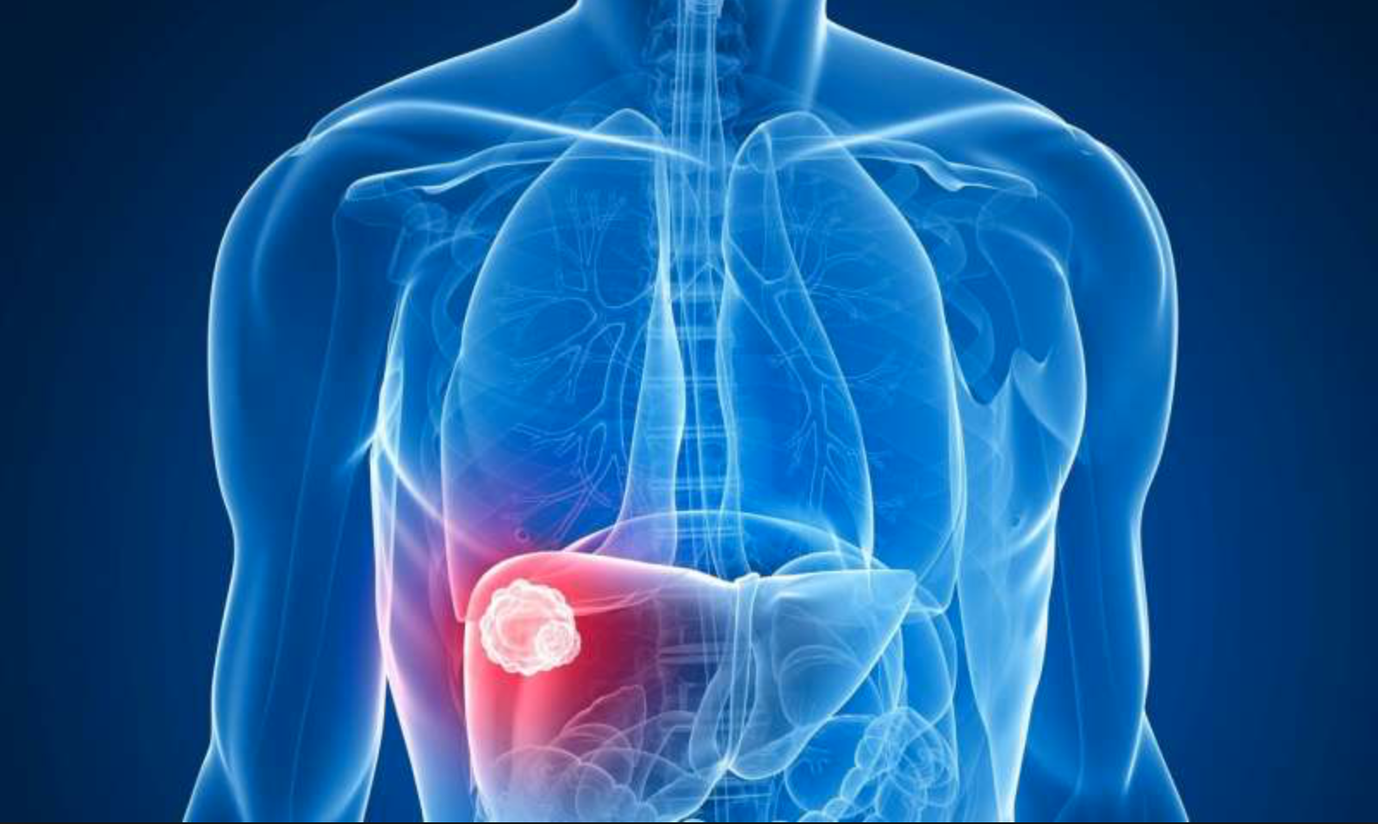
Predicting One Year Survival of Patients with Hepatocellular Carcinoma: A Logistic Regression Model
Pablo Salcedo, M.D.

Slide 2
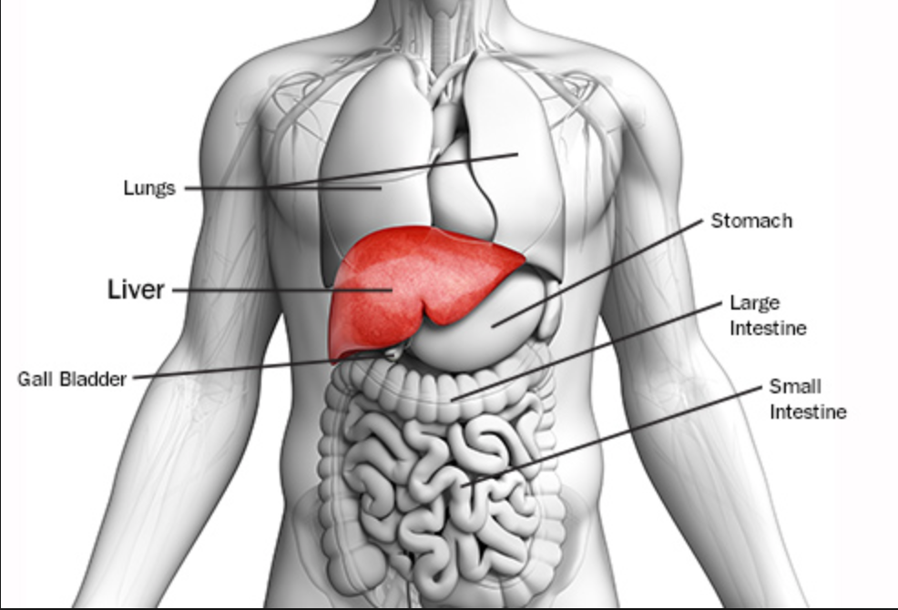
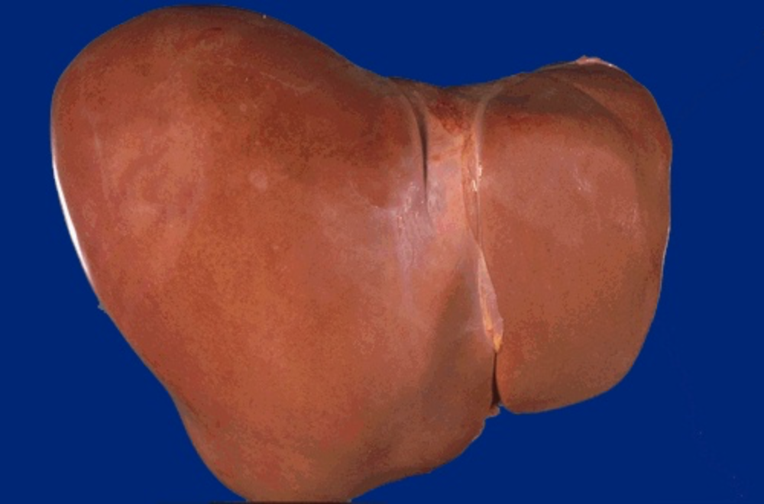
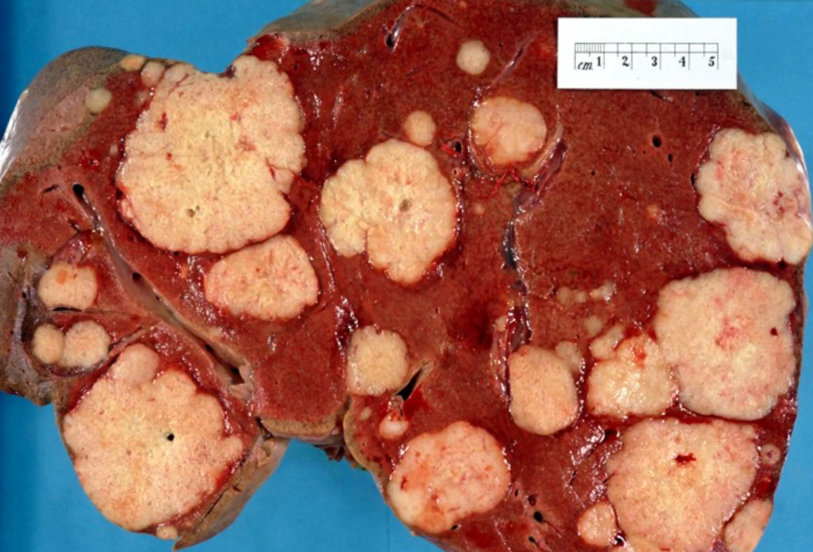
Hepatocellular Carcinoma (Liver Cancer)
Notes:
The liver is a football sized organ nestled under the diaphragm in the URQ.
The most common type of liver cancer is hepatocellular carcinoma, which begins in the main type of liver cell (hepatocyte)
For the most part, cancer research and diagnoses is largely based on tumor staging classification. Studies are showing a need to expand beyond only staging, for predicting the outcome of cancer patients. Patient cluster analysis generates homogeneous groups, with similar prognostic features, that traject onto similar survival patterns and more accurate predictions.
Most people don't have signs and symptoms in the early stages of primary liver cancer. When signs and symptoms do appear, they may include:
Losing weight without trying
Loss of appetite
Upper abdominal pain
Nausea and vomiting
General weakness and fatigue
Abdominal swelling
Yellow discoloration of your skin and the whites of your eyes (jaundice)
White, chalky stools

Slide 3
Why Should We Be Concerned
Notes:
One out of every six deaths that occur in the world are due to cancer. Cancer is second only to cardiovascular disease in all-cause mortality globally. Liver cancer (hepatocellular carcinoma) is consistently ranked as one of the most common forms of cancer and is one of the most lethal (Figure 1), with a 5-year survival rate of about 15% in the USA (Figure 2).
Estimated that 30,000 Americans will die from liver cancer this year.

Slide 4
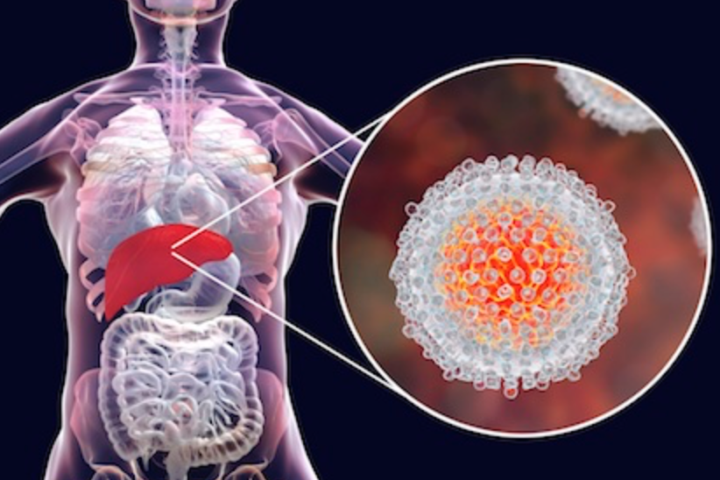
Model Intent
To provide a robust alternative diagnostic model for predicting patient
liver cancer mortality beyond stage classification.
Notes:
GOAL: The purpose of this model, in predicting whether a patient diagnosed with hepatocellular carcinoma will survive past one year in conjunction with established guidelines, is to reduce mortality rate secondary to hepatocellular carcinoma.
This logistic regression model would prove most useful to clinicians, patients, and policy makers alike—as they grapple with the cancer decision making process and potential treatment options. Ideally, machine learning and statistical models will find a place in depicting a completer and more holistic predictive patient profile.
METHOD: Creating a logistic regression model capable of predicting whether a patient diagnosed with hepatocellular carcinoma will survive past one year
AUDIENCE: Clinicians, patients, and policy makers

Slide 5
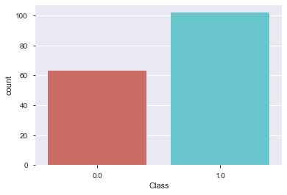
The Patient “Profile”
Lifestyle factors
Left: Features Selection
Liver Function
Signs & Symptoms
Blood Marker Tests
Below: Target Class Distribution
Comorbidities
Notes:
This hepatocellular carcinoma dataset consists of patient data from 165 former patients of Hospital and University Centre of Coimbra (Portugal). The dataset contains 49 features selected according to the EASL-EORTC (European Association for the Study of the Liver - European Organization for Research and Treatment of Cancer) Clinical Practice Guidelines. The target variable, "Class", is the survival of each patient at 1 year and is represented as 0 (deceased) and 1 (alive).
Many of the features for which patient data was collected are important risk factors for the development of HCC. In the table below some of the key features included in the model are detailed.

Slide 6
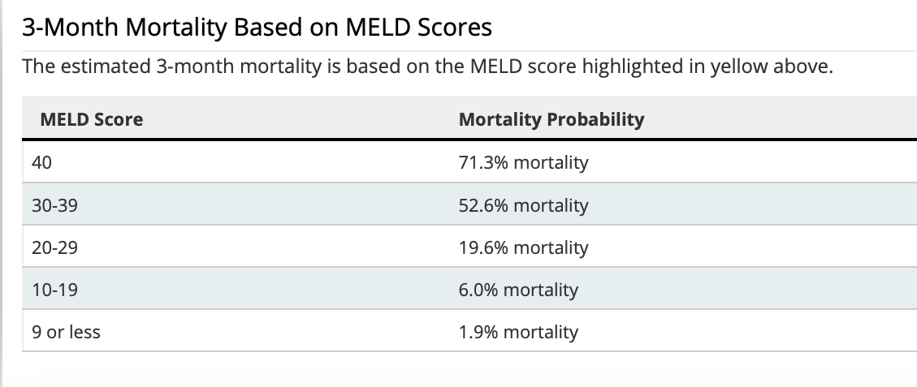
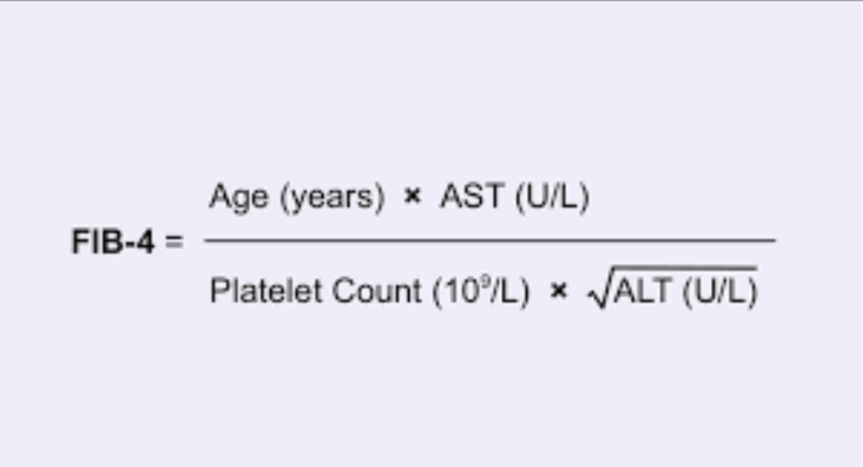
Optimization Techniques
K- nearest neighbor
Notes:
Prior to running the logistic model, gender was binarized into male and female and two additional features were created.
The Model for End-Stage Liver Disease Score (MELD) is a widely used clinical scoring method to predict 3 month mortality rates in patients with end-stage liver disease. It stratifies severity of end-stage liver disease for transplant planning. (MELD=>Creatinine, Bilirubin, Albumin, Sodium, INR)
The second feature created was a Fibrosis-4 Index (FIB-4) score. The FIB-4 Index score is a noninvasive estimate of liver scarring in HCV and HBV patients. Together these 2 features contributed an approximate 3% improvement to the model's overall predictive ability.
A unique aspect of healthcare data in general, is the "patient profile" that is created when a broad amount of data is collected for each unique patient. In order to preserve the heterogeneity of the patient profile and provide a more accurate estimation of missing patient values, missing values were imputed via a K-nearest neighbor (KNN) model. The most similar of the 3 closest patient records was utilized to fill in the corresponding missing values in question.
In order to address the class imbalance (greater number of living patients at 1 year than deceased) inherit to the HCC dataset, SMOTE (Synthetic Minority Over-sampling Technique) was utilized. Prior to smote, the training data consisted of 115 patient records, after SMOTE, 146 patient records were available for model training use.
Finally, a grid search was utilized to optimize parameters and assign most appropriate penalty weights prior to running the logistic model.

Slide 7
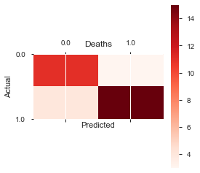
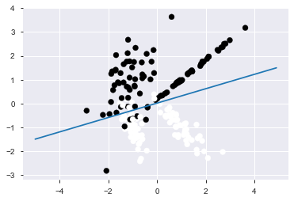
Model Results
Figure B: Decision Boundary Graph
Figure A: Confusion Matrix
Area Under Curve (AUC): 0.83
Accuracy: 0.82
Testing F1-Score: 0.83
False Positive Rate: 0.14
0 1
----- -----
0 | TN | FP
----- -----
1 | FN | TP
Notes:
The performance of the logistic model was assessed by utilizing the performance measures of accuracy, AUC, and F-1 score. Particular attention was given to minimizing the false positive rate, as the threshold for incorrectly predicting that a patient would live at least 1 more year (Class=1) is minimal.
AUC:83%
Accuracy: 82%
F1-score=83%
N=33 patients in testing set
TN (patients correctly predicted to be deceased in a year)= 13/33
FP (patients incorrectly predicted to be alive in a year)=2/33
TP (patients correctly predicted to still be alive in a year)=14/33
FN (patients incorrectly predicted to be deceased in a year)=3/33
FPR(% patients incorrectly predicted to be alive in a year out of all patients that die in a year)=14%
FPR=FP/(FP+TN)
provided higher predictive value compared to other models such as Support Vector Machine (SVM) and Random Forest Ensemble.

Slide 8
Discussion
Potential use of this model as a diagnostic tool for
hepatocellular carcinoma (HCC)
Earlier disease stage intervention
Capturing patient heterogeneity
through the use of clustering
oversampling techniques to
predict trends such as
treatment response
Areas of future work
Notes:
By providing a convenient and quickly accessible HCC diagnostic tool, this model can serve as a supplement in patient decision making. By combining machine learning’s ability to analyze large datasets in minimal time with decision makers’ context knowledge, more robust and efficient clinical decisions can be made earlier in the disease lifecycle resulting in better clinical outcomes.
For the most part, cancer research and diagnoses is largely based on tumor staging classification. Studies are showing a need to expand beyond only staging, for predicting the outcome of cancer patients. Patient cluster analysis generates homogeneous groups, with similar prognostic features, the ability to examine similar survival patterns, and more accurate predictions.
2) By allowing for earlier disease stage intervention patient treatment options increase significantly. Localized treatments such as radiofrequency ablation, cryoablation, chemoembolization, and surgical resection are available. Once the disease extends past the liver capsule-these options disappear for the most part and limited systemic approaches with a greater risk and side effect profile have to be used (systemic chemotherapy or liver transplant)
3) In order to capture the heterogeneity for each patient profile, as well as the dataset class imbalance, clustering oversampling techniques were utilized. All performance measures improved with the use of KNN (K-nearest Neighbor) to impute missing patient data as well as with the addition of the SMOTE oversampling technique to address class imbalance
4) Areas of future work include training predictive models on larger patient datasets—a task easier said than done in the realm of healthcare. Furthermore, applying this model to other disease classification scenarios has the potential to positively impact how decision makers approach diagnoses and optimal treatment options. The concept of utilizing clustering techniques to fill in missing data for patients may prove promising for future healthcare models that aim to preserve patient profile heterogeneity.
------------
The majority of liver cancer cases are detected at advanced stages of disease, when treatment options are severely limited in both quantity and effectiveness. With this in mind, more effective screening and earlier cancer detection has the most potential to save lives and reduce disease cost burden.

Slide 9

References
Miriam Seoane Santos, Pedro Henriques Abreu, Pedro J Garcia-Laencina, Adelia Simao, Armando Carvalho, A new cluster-based oversampling method for improving survival prediction of hepatocellular carcinoma patients. Journal of biomedical informatics, 58, 49-59, 2015.
- "Cancer" Roser, M., Ritchie, H. 2019.'https://ourworldindata.org/cancer'
- "Liver Cancer." 2019. *Elsevier B.V.* www.sciencedirect.com/topics/medicine-and-dentistry/liver-cancer
Questions
Pablo Salcedo, MD
Flatiron School Data Science Fellow
pablosalcedo@verizon.net

